Slide 1


SIMATS ENGINEERING
Saveetha Institute of Medical and Technical Sciences Chennai-602105.
Inflectional Morphology: Understanding Grammatical Variations in Natural Language Processing
Name: A. Ashriktha Reddy
Reg no:(192424172)
Course Code:DSA0304
Course Name: Natural Language Processing
Supervisor,
Dr T Devi,
SIMATS Engineering

Slide 2
Introduction
Imagine you search for the word “cook" on Google.
Even if a document contains “cooked," “cooking," or “cooks," Google still finds the correct results.
How does it know that all these words are related?
The answer is Inflectional Morphology.
Inflectional Morphology
Inflectional Morphology is a branch of Morphology that studies how the grammatical form of a word changes while preserving its core meaning and part of speech. These variations express grammatical information such as tense, number, comparison, and possession.

Slide 3
How Does Inflectional Morphology Work?
Starts with the root (base) word.
Adds inflectional suffixes to express grammatical information.
The meaning remains unchanged. The part of speech remains the same.
Helps NLP systems identify different forms of the same word.
Root Word | Inflected Forms | Grammatical Change
Read | Reads, Reading, Read | Tense
Child | Children | Number
Fast | Faster, Fastest | Degree

Slide 4
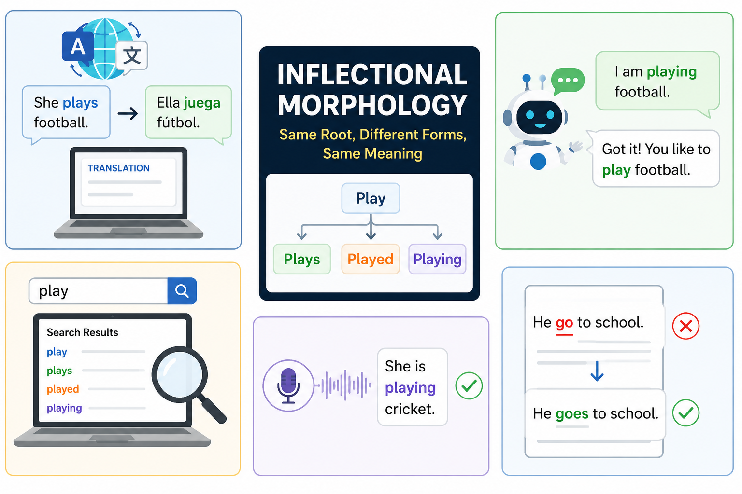
Applications of Inflectional Morphology
Used in Grammar Checking and Text Processing systems.
Improves Machine Translation by preserving grammatical forms.
Helps Chatbots & Virtual Assistants understand word variations.
Enhances Search Engines by recognizing related word forms.
Supports Speech Recognition for accurate language processing.

Slide 5
Visual Flow
Root Word
↓
Cook
↓
+ s → Cooks
+ ed → Cooked
+ ing → Cooking
↓
Same Meaning
Different Grammatical Forms
Explanation:
Root Word: Cook
Inflectional Suffixes: -s, -ed, -ing
Result: Creates different grammatical forms.
Core Meaning: Remains “Cook".
Part of Speech: Remains Verb.

Slide 6
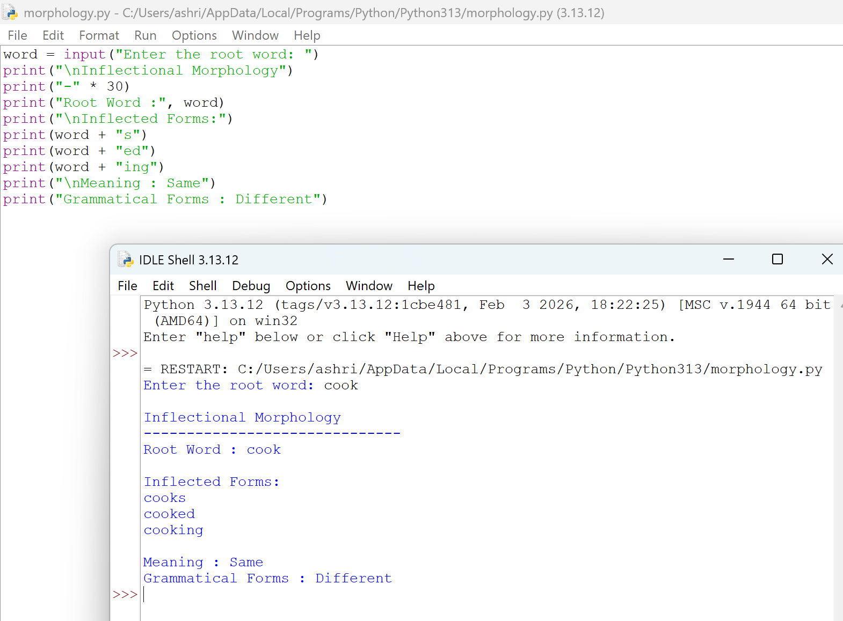
Python Demonstration of Inflectional Morphology
Input
Play
Code:
word = input("Enter the root word: ")
print("\nInflectional Morphology")
print("-" * 30)
print("Root Word :", word)
print("\nInflected Forms:")
print(word + "s")
print(word + "ed")
print(word + "ing")
print("\nMeaning : Same")
print("Grammatical Forms : Different")

Slide 7
Thank you

